Slide 1
Advanced Topics
Data Visualization Fractals & L-Systems Image Processing

Slide 2
Where in the book?
Data Visualization Chapter 5, 7
Fractals & L-Systems Chapter 8
Image Processing Chapter 9, 10

Slide 3
Data Visualization - Basics
Get data
Clean it up
Plan layout
Read and parse data
Computer/process data, if needed
Draw basic plot
Make it interactive
Label the data and axes
Add title, legend, …

Slide 4
Sales Data (US $ in thousands)
Region | Jan | Feb | Mar | Apr | May | Jun | Jul | Aug | Sep | Oct | Nov | Dec
Domestic | 1983 | 2343 | 2593 | 2283 | 2574 | 2838 | 2382 | 2634 | 2938 | 2739 | 2983 | 3413
International | 574 | 636 | 573 | 593 | 644 | 679 | 593 | 139 | 599 | 583 | 602 | 690

Slide 5
Sales Data (US $ in thousands)
Region | Jan | Feb | Mar | Apr | May | Jun | Jul | Aug | Sep | Oct | Nov | Dec
Domestic | 1983 | 2343 | 2593 | 2283 | 2574 | 2838 | 2382 | 2634 | 2938 | 2739 | 2983 | 3413
International | 574 | 636 | 573 | 593 | 644 | 679 | 593 | 139 | 599 | 583 | 602 | 690

Slide 6
Causes of Deaths in US in 2007
Cause of Death | Deaths per year | %
Heart Disease | 616067 | 25.42
Cancer | 562875 | 23.22
Stroke | 135952 | 5.61
Chronic Lower Respiratory Diseases | 127924 | 5.28
Accidents | 123706 | 5.10
Alzheimer's Disease | 74632 | 3.08
Diabetes | 71382 | 2.95
Influenza and Pneumonia | 52717 | 2.18
Nephritis and Nephrosis | 46448 | 1.92
Septicemia | 34828 | 1.44
Other Causes | 577181 | 23.81
Totals | 2423712

Slide 7
Causes of Deaths in US in 2007
Cause of Death | Deaths per year | %
Heart Disease | 616067 | 25.42
Cancer | 562875 | 23.22
Stroke | 135952 | 5.61
Chronic Lower Respiratory Diseases | 127924 | 5.28
Accidents | 123706 | 5.10
Alzheimer's Disease | 74632 | 3.08
Diabetes | 71382 | 2.95
Influenza and Pneumonia | 52717 | 2.18
Nephritis and Nephrosis | 46448 | 1.92
Septicemia | 34828 | 1.44
Other Causes | 577181 | 23.81
Totals | 2423712

Slide 8
Causes of Deaths in US in 2007
Criteria for effectiveness
Clearly indicates the nature of the relationship?
Represents the Quantities accurately?
Makes it easy to compare quantities?
Makes it easy to see ranked order of values?
Makes obvious how people should use the information?

Slide 9
Causes of Deaths in US in 2007
Criteria for effectiveness
Clearly indicates the nature of the relationship? Yes
Represents the Quantities accurately? No
Makes it easy to compare quantities? No
Makes it easy to see ranked order of values? No
Makes obvious how people should use the information? Partially

Slide 10
Causes of Deaths in US in 2007
Cause of Death | Deaths per year | %
Heart Disease | 616067 | 25.42
Cancer | 562875 | 23.22
Stroke | 135952 | 5.61
Chronic Lower Respiratory Diseases | 127924 | 5.28
Accidents | 123706 | 5.10
Alzheimer's Disease | 74632 | 3.08
Diabetes | 71382 | 2.95
Influenza and Pneumonia | 52717 | 2.18
Nephritis and Nephrosis | 46448 | 1.92
Septicemia | 34828 | 1.44
Other Causes | 577181 | 23.81
Totals | 2423712

Slide 11
Causes of Deaths in US in 2007
Criteria for effectiveness
Clearly indicates the nature of the relationship?
Represents the Quantities accurately?
Makes it easy to compare quantities?
Makes it easy to see ranked order of values?
Makes obvious how people should use the information?

Slide 12
Causes of Deaths in US in 2007
Criteria for effectiveness
Clearly indicates the nature of the relationship? Yes
Represents the Quantities accurately? Yes
Makes it easy to compare quantities? Yes
Makes it easy to see ranked order of values? Yes
Makes obvious how people should use the information? Yes

Slide 13
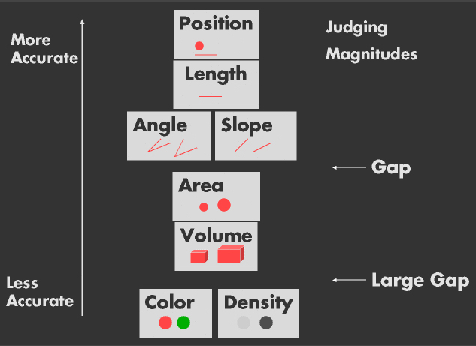
Accuracy Ranking of Basic Charts
From: Graphical Perception: Theory, Experimentation, and Application to the Development of Graphical Methods
William S. Cleveland; Robert McGill, Journal of the American Statistical Association, Vol. 79, No. 387. (Sep., 1984), pp. 531-554.

Slide 14
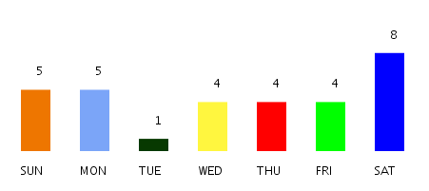
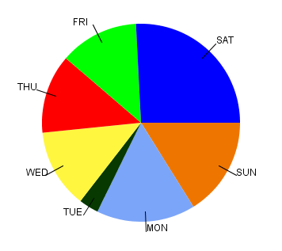
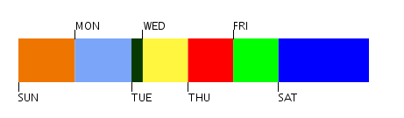
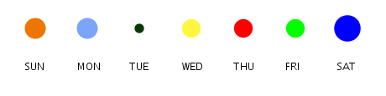
% Births by Day of Week

Slide 15
Top Medals in Olympics by Country (1992-2012)
Country | 2012 | 2008 | 2004 | 2000 | 1996 | 1992
United States of America | 104 | 110 | 103 | 92 | 101 | 108
People's Republic of China | 88 | 100 | 63 | 59 | 50 | 54
Russian Federation | 82 | 72 | 92 | 88 | 63 | 112
Great Britain | 65 | 47 | 30 | 28 | 15 | 20
Australia | 35 | 46 | 49 | 58 | 41 | 27
Germany | 44 | 41 | 49 | 56 | 65 | 82
France | 34 | 40 | 33 | 38 | 37 | 29
Republic of Korea | 28 | 31 | 30 | 28 | 27 | 29
Japan | 38 | 25 | 37 | 18 | 14 | 22
Italy | 28 | 27 | 32 | 34 | 35 | 19

Slide 16
Top Medals in Olympics by Country (1992-2012)

Slide 17
Top Medals in Olympics by Country (1992-2012)
Focus on
Germany
China
Great Britain

Slide 18
Visualizing Time Series
Raw Data
1,4,2010,213.43,214.50,214.01,17633200
1,5,2010,214.60,215.59,214.38,21496600
1,6,2010,214.38,215.23,210.97,19720000
1,7,2010,211.75,212.00,210.58,17040400
1,8,2010,210.30,212.00,211.98,15986100
…
12,27,2010,322.85,325.44,324.68,8922000
12,28,2010,325.91,326.66,325.47,6283000
12,29,2010,326.22,326.45,325.29,5826400
12,30,2010,325.48,325.51,323.66,5624800
12,31,2010,322.95,323.48,322.56,6911000

Slide 19
Visualizing Time Series

Slide 20
Visualizing Time Series

Slide 21
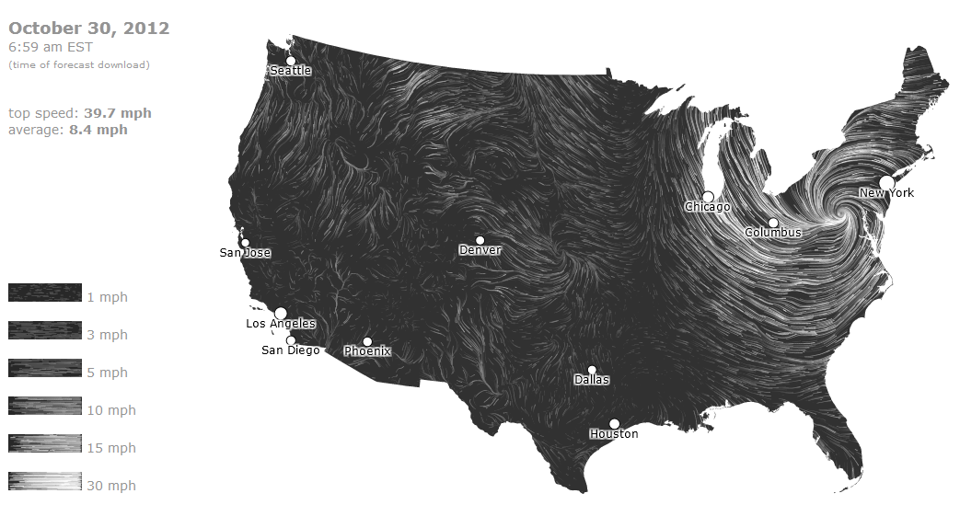
Data Visualization

Slide 22
Text Processing & Visualization
Obama Nobel Peace Prize Acceptance Speech December 2009
Your Majesties, Your Royal Highnesses, Distinguished Members of the Norwegian Nobel Committee, citizens of America, and citizens of the world:
I receive this honor with deep gratitude and great humility. It is an award that speaks to our highest aspirations - that for all the cruelty and hardship of our world, we are not mere prisoners of fate. Our actions matter, and can bend history in the direction of justice. And yet I would be remiss if I did not acknowledge the considerable controversy that your generous decision has generated. In part, this is because I am at the beginning, and not the end, of my labors on the world stage. Compared to some of the giants of history who have received this prize - Schweitzer and King; Marshall and Mandela - my accomplishments are slight. And then there are the men and women around the world who have been jailed and beaten in the pursuit of justice; those who toil in humanitarian organizations to relieve suffering; the unrecognized millions whose quiet acts of courage and compassion inspire even the most hardened of cynics. I cannot argue with those who find these men and women - some known, some obscure to all but those they help - to be far more deserving of this honor than I.
But perhaps the most profound issue surrounding my receipt of this prize is the fact that I am the Commander-in-Chief of a nation in the midst of two wars. One of these wars is winding down. The other is a conflict that America did not seek; one in which we are joined by forty three other countries - including Norway - in an effort to defend ourselves and all nations from further attacks. Still, we are at war, and I am responsible for the deployment of thousands of young Americans to battle in a distant land. Some will kill. Some will be killed. And so I come here with an acute sense of the cost of armed conflict - filled with difficult questions about the relationship between war and peace, and our effort to replace one with the other.
These questions are not new. War, in one form or another, appeared with the first man. At the dawn of history, its morality was not questioned; it was simply a fact, like drought or disease - the manner in which tribes and then civilizations sought power and settled their differences. Over time, as codes of law sought to control violence within groups, so did philosophers, clerics, and statesmen seek to regulate the destructive power of war. The concept of a "just war" emerged, suggesting that war is justified only when it meets certain preconditions: if it is waged as a last resort or in self-defense; if the forced used is proportional, and if, whenever possible, civilians are spared from violence.
For most of history, this concept of just war was rarely observed. The capacity of human beings to think up new ways to kill one another proved inexhaustible, as did our capacity to exempt from mercy those who look different or pray to a different God. Wars between armies gave way to wars between nations - total wars in which the distinction between combatant and civilian became blurred. In the span of thirty years, such carnage would twice engulf this continent. And while it is hard to conceive of a cause more just than the defeat of the Third Reich and the Axis powers, World War II was a conflict in which the total number of civilians who died exceeded the number of soldiers who perished.
In the wake of such destruction, and with the advent of the nuclear age, it became clear to victor and vanquished alike that the world needed institutions to prevent another World War. And so, a quarter century after the United States Senate rejected the League of Nations - an idea for which Woodrow Wilson received this Prize - America led the world in constructing an architecture to keep the peace: a Marshall Plan and a United Nations, mechanisms to govern the waging of war, treaties to protect human rights, prevent genocide, and restrict the most dangerous weapons.
In many ways, these efforts succeeded. Yes, terrible wars have been fought, and atrocities committed. But there has been no Third World War. The Cold War ended with jubilant crowds dismantling a wall. Commerce has stitched much of the world together. Billions have been lifted from poverty. The ideals of liberty, self-determination, equality and the rule of law have haltingly advanced. We are the heirs of the fortitude and foresight of generations past, and it is a legacy for which my own country is rightfully proud.
….
Let us live by their example. We can acknowledge that oppression will always be with us, and still strive for justice. We can admit the intractability of depravation, and still strive for dignity. We can understand that there will be war, and still strive for peace. We can do that - for that is the story of human progress; that is the hope of all the world; and at this moment of challenge, that must be our work here on Earth.

Slide 23
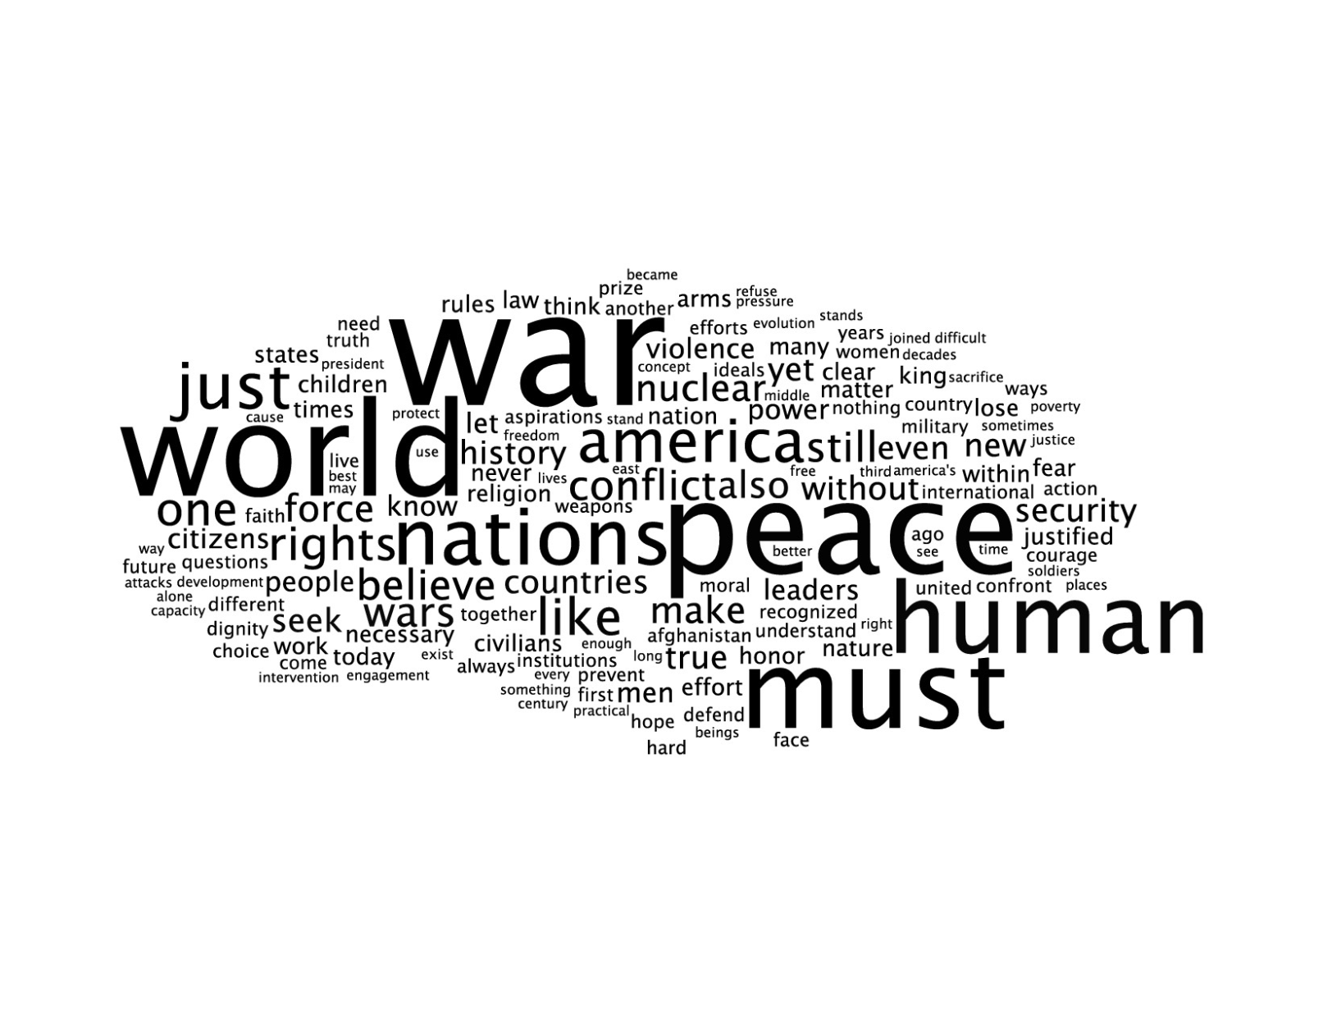
Text Processing & Visualization
Obama Nobel Peace Prize Acceptance Speech December 2009
Your Majesties, Your Royal Highnesses, Distinguished Members of the Norwegian Nobel Committee, citizens of America, and citizens of the world:
I receive this honor with deep gratitude and great humility. It is an award that speaks to our highest aspirations - that for all the cruelty and hardship of our world, we are not mere prisoners of fate. Our actions matter, and can bend history in the direction of justice. And yet I would be remiss if I did not acknowledge the considerable controversy that your generous decision has generated. In part, this is because I am at the beginning, and not the end, of my labors on the world stage. Compared to some of the giants of history who have received this prize - Schweitzer and King; Marshall and Mandela - my accomplishments are slight. And then there are the men and women around the world who have been jailed and beaten in the pursuit of justice; those who toil in humanitarian organizations to relieve suffering; the unrecognized millions whose quiet acts of courage and compassion inspire even the most hardened of cynics. I cannot argue with those who find these men and women - some known, some obscure to all but those they help - to be far more deserving of this honor than I.
But perhaps the most profound issue surrounding my receipt of this prize is the fact that I am the Commander-in-Chief of a nation in the midst of two wars. One of these wars is winding down. The other is a conflict that America did not seek; one in which we are joined by forty three other countries - including Norway - in an effort to defend ourselves and all nations from further attacks. Still, we are at war, and I am responsible for the deployment of thousands of young Americans to battle in a distant land. Some will kill. Some will be killed. And so I come here with an acute sense of the cost of armed conflict - filled with difficult questions about the relationship between war and peace, and our effort to replace one with the other.
….
Let us live by their example. We can acknowledge that oppression will always be with us, and still strive for justice. We can admit the intractability of depravation, and still strive for dignity. We can understand that there will be war, and still strive for peace. We can do that - for that is the story of human progress; that is the hope of all the world; and at this moment of challenge, that must be our work here on Earth.

Slide 24
Text Processing & Visualization
Obama Nobel Peace Prize Acceptance Speech December 2009
Your Majesties, Your Royal Highnesses, Distinguished Members of the Norwegian Nobel Committee, citizens of America, and citizens of the world:
I receive this honor with deep gratitude and great humility. It is an award that speaks to our highest aspirations - that for all the cruelty and hardship of our world, we are not mere prisoners of fate. Our actions matter, and can bend history in the direction of justice. And yet I would be remiss if I did not acknowledge the considerable controversy that your generous decision has generated. In part, this is because I am at the beginning, and not the end, of my labors on the world stage. Compared to some of the giants of history who have received this prize - Schweitzer and King; Marshall and Mandela - my accomplishments are slight. And then there are the men and women around the world who have been jailed and beaten in the pursuit of justice; those who toil in humanitarian organizations to relieve suffering; the unrecognized millions whose quiet acts of courage and compassion inspire even the most hardened of cynics. I cannot argue with those who find these men and women - some known, some obscure to all but those they help - to be far more deserving of this honor than I.
But perhaps the most profound issue surrounding my receipt of this prize is the fact that I am the Commander-in-Chief of a nation in the midst of two wars. One of these wars is winding down. The other is a conflict that America did not seek; one in which we are joined by forty three other countries - including Norway - in an effort to defend ourselves and all nations from further attacks. Still, we are at war, and I am responsible for the deployment of thousands of young Americans to battle in a distant land. Some will kill. Some will be killed. And so I come here with an acute sense of the cost of armed conflict - filled with difficult questions about the relationship between war and peace, and our effort to replace one with the other.
….
Let us live by their example. We can acknowledge that oppression will always be with us, and still strive for justice. We can admit the intractability of depravation, and still strive for dignity. We can understand that there will be war, and still strive for peace. We can do that - for that is the story of human progress; that is the hope of all the world; and at this moment of challenge, that must be our work here on Earth.

Slide 25
Text Processing & Visualization
Obama Nobel Peace Prize Acceptance Speech December 2009
Your Majesties, Your Royal Highnesses, Distinguished Members of the Norwegian Nobel Committee, citizens of America, and citizens of the world:
I receive this honor with deep gratitude and great humility. It is an award that speaks to our highest aspirations - that for all the cruelty and hardship of our world, we are not mere prisoners of fate. Our actions matter, and can bend history in the direction of justice. And yet I would be remiss if I did not acknowledge the considerable controversy that your generous decision has generated. In part, this is because I am at the beginning, and not the end, of my labors on the world stage. Compared to some of the giants of history who have received this prize - Schweitzer and King; Marshall and Mandela - my accomplishments are slight. And then there are the men and women around the world who have been jailed and beaten in the pursuit of justice; those who toil in humanitarian organizations to relieve suffering; the unrecognized millions whose quiet acts of courage and compassion inspire even the most hardened of cynics. I cannot argue with those who find these men and women - some known, some obscure to all but those they help - to be far more deserving of this honor than I.
But perhaps the most profound issue surrounding my receipt of this prize is the fact that I am the Commander-in-Chief of a nation in the midst of two wars. One of these wars is winding down. The other is a conflict that America did not seek; one in which we are joined by forty three other countries - including Norway - in an effort to defend ourselves and all nations from further attacks. Still, we are at war, and I am responsible for the deployment of thousands of young Americans to battle in a distant land. Some will kill. Some will be killed. And so I come here with an acute sense of the cost of armed conflict - filled with difficult questions about the relationship between war and peace, and our effort to replace one with the other.
….
Let us live by their example. We can acknowledge that oppression will always be with us, and still strive for justice. We can admit the intractability of depravation, and still strive for dignity. We can understand that there will be war, and still strive for peace. We can do that - for that is the story of human progress; that is the hope of all the world; and at this moment of challenge, that must be our work here on Earth.

Slide 26
Text Processing & Visualization
Obama Nobel Peace Prize Acceptance Speech December 2009
Your Majesties, Your Royal Highnesses, Distinguished Members of the Norwegian Nobel Committee, citizens of America, and citizens of the world:
I receive this honor with deep gratitude and great humility. It is an award that speaks to our highest aspirations - that for all the cruelty and hardship of our world, we are not mere prisoners of fate. Our actions matter, and can bend history in the direction of justice. And yet I would be remiss if I did not acknowledge the considerable controversy that your generous decision has generated. In part, this is because I am at the beginning, and not the end, of my labors on the world stage. Compared to some of the giants of history who have received this prize - Schweitzer and King; Marshall and Mandela - my accomplishments are slight. And then there are the men and women around the world who have been jailed and beaten in the pursuit of justice; those who toil in humanitarian organizations to relieve suffering; the unrecognized millions whose quiet acts of courage and compassion inspire even the most hardened of cynics. I cannot argue with those who find these men and women - some known, some obscure to all but those they help - to be far more deserving of this honor than I.
But perhaps the most profound issue surrounding my receipt of this prize is the fact that I am the Commander-in-Chief of a nation in the midst of two wars. One of these wars is winding down. The other is a conflict that America did not seek; one in which we are joined by forty three other countries - including Norway - in an effort to defend ourselves and all nations from further attacks. Still, we are at war, and I am responsible for the deployment of thousands of young Americans to battle in a distant land. Some will kill. Some will be killed. And so I come here with an acute sense of the cost of armed conflict - filled with difficult questions about the relationship between war and peace, and our effort to replace one with the other.
….
Let us live by their example. We can acknowledge that oppression will always be with us, and still strive for justice. We can admit the intractability of depravation, and still strive for dignity. We can understand that there will be war, and still strive for peace. We can do that - for that is the story of human progress; that is the hope of all the world; and at this moment of challenge, that must be our work here on Earth.

Slide 27
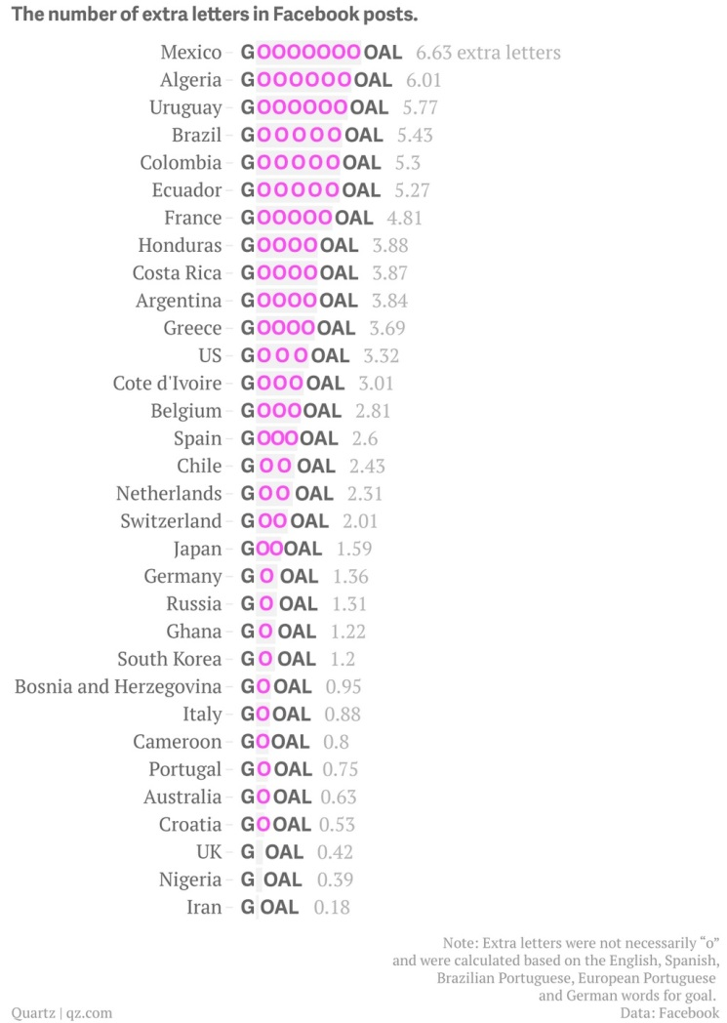

Slide 28
Drawing with recursion

Slide 29
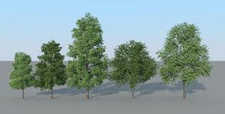
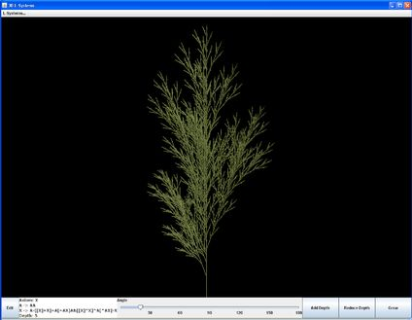
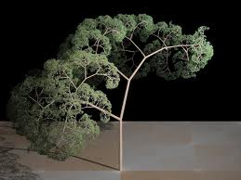
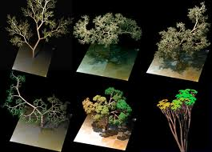
Drawing with recursion

Slide 30
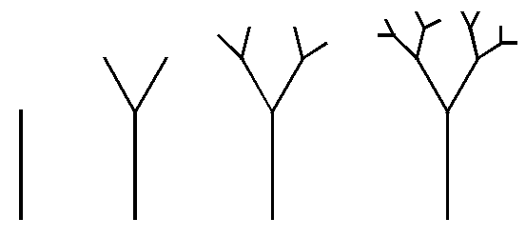
Drawing with recursion

Slide 31
Drawing with recursion
void setup() { size(800, 800); background(255); stroke(156, 171, 61); drawTree(width/2, height, 175, 90); } // end setup()
void drawTree(float x0, float y0, float len, float angle) { if (len > 2) { float x1 = x0 + cos(radians(angle))*len; float y1 = y0 - sin(radians(angle))*len; line(x0, y0, x1, y1); drawTree(x1, y1, len * 0.75, angle + 30); drawTree(x1, y1, len * 0.66, angle - 50);
} // end drawTree()

Slide 32
Drawing with recursion

Slide 33
Lindenmayer Systems
Grammar
Alphabet: {A, B}
Axiom: A
Rules: (A → AB), (B → A)
Derivation
A
AB
ABA
ABAAB
ABAABABA

Slide 34
Lindenmayer Systems
Grammar: Turtle Graphics
Alphabet: {F}
Axiom: F
Rules: (F → F+F-F-F+F)
Interpretation
F: move forward one unit (pen down)
+: turn left (pen up)
-: turn right (pen down)

Slide 35
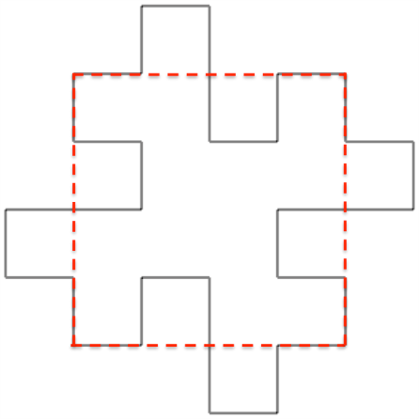
Lindenmayer Systems
Koch Snowflake
Alphabet: {F}
Axiom: F++F++F
Rules: (F → F-F++F-F)
Quadratic Flake
Alphabet: {F}
Axiom: F++F++F
Rules: (F → F-F++F-F)

Slide 36
Image Processing

Slide 37
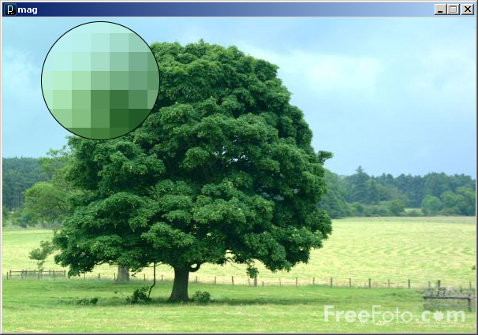
Image Processing
An image is an array of colors
0
1
2
3
…
98
99
100
101
102
103
…
198
199
200
201
202
203
…
298
299
300
301
302
303
…
398
399
400
401
402
403
…
498
499
500
501
502
503
…
598
599
600
601
602
603
…
698
699
700
701
702
703
…
798
799
800
801
802
803
…
898
899
…
…
…
…
…
…
…
Pixel : Picture Element
mag.pde

Slide 38
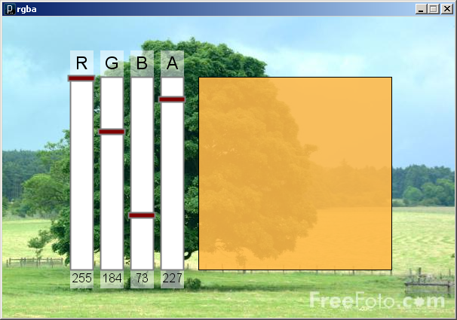
Image Processing
Color
A triple of bytes [0, 255]
RGB or HSB
Transparency (alpha)
How to blend a new pixel color with an existing pixel color
rgba.pde

Slide 39
Image Processing
Accessing the pixels of a sketch
loadPixels()
Loads the color data out of the sketch window into a 1D array of colors named pixels[]
The pixels[] array can be modified
updatePixels()
Copies the color data from the pixels[] array back to the sketch window

Slide 40
Image Processing
0
1
2
3
…
98
99
A 100-pixel wide image
First pixel at index 0
Right-most pixel in first row at index 99
First pixel of second row at index 100
100
101
102
103
198
199
…
200
201
202
203
…
298
299
300
301
302
303
…
398
399
400
401
402
403
…
498
499
500
501
502
503
…
598
599
600
601
602
603
…
698
699
700
701
702
703
…
798
799
800
801
802
803
…
898
899
…
…
…
…
…
…
…
The pixels[] array is one-dimensional
0
1
2
3
…
98
99
100
101
102
103
…
198
199
200
101
102
103
…

Slide 41
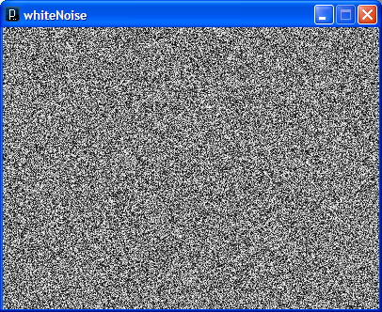
Image Processing
// whiteNoise
void setup() {
size(400, 300);
}
void draw() {
float b;
// Load colors into the pixels array
loadPixels();
// Fill pixel array with a random
// grayscale value
for (int i=0; i<pixels.length; i++) {
b = random(0, 255);
pixels[i] = color(b);
}
// Update the sketch with pixel data
updatePixels();
}
See also colorNoise.pde

Slide 42
Image Processing
Accessing Pixels as a 2D Array
Pixels can be accessed as a 2D array using the following formula:
index = r * width + c
index = y * width + x
Using 0-based indices
int idx = width*r + c;
pixels[idx] = color(b);

Slide 43

Image Processing
// cone
void setup() {
size(400, 400);
// Load colors into the pixels array
loadPixels();
// Access pixels as a 2D array
for (int y=0; y<height; y++) {
for (int x=0; x<width; x++) {
// Compute distance to center point
float d = dist(x, y, width/2, height/2);
// Set pixel as distance to center
pixels[y*height+x] = color(d);
}
}
// Update the sketch with pixel data
updatePixels();
}

Slide 44
Image Processing
Rendering Images in a Sketch
Image data can be loaded from a file using loadImage() method, and drawn on a sketch with the image() command
The PImage object also permits individual pixel color data to be modified.
like the sketch window
PImage img = loadImage("myImage.jpg");
image(img, 0, 0);

Slide 45
Image Processing
PImage
Fields
width - the width of the image
height - the height of the image
pixels[] - the image pixel colors
(after a call to loadPixels())

Slide 46
Image Processing
PImage
Methods
loadPixels()
Loads the color data out of the PImage object into a 1D array of colors named pixels[].
updatePixels()
Copies the color data from the pixels[] array back to the PImage object.
Also
red(color) extract the red component of from color
blue(color) extract the green component from a color
green(color) extract the blue component from a color

Slide 47
Basic Filters
Image Processing
Color
Extracting Red/Green/Blue colors
pixels[i] = color(red(c), 0, 0);
pixels[i] = color(0, 0, blue(c));
Grayscale
pixels[i] = color(0.3*red(c)+ 0.59*green(c)+ 0.11*blue(c));
Negative
pixels[i] = color(255-red(c), 255-green(c), 255-blue(c));

Slide 48
Sepia
Image Processing
Technique for archiving BW photos
float r = red(c)*0.393+green(c)*0.769+blue(c)*0.189;
float g = red(c)*0.349+green(c)*0.686+blue(c)*0.168;
float b = red(c)*0.272+green(c)*0.534+blue(c)*0.131;
pixels[i] = color(r, g, b);

Slide 49
Image Processing
PImage
Methods (Cont'd)
get(…) Reads the color of any pixel or grabs a rectangle of pixels
set(…) Writes a color to any pixel or writes an image into another
copy(…) Copies pixels from one part of an image to another
mask(…) Masks part of the image from displaying
save(…) Saves the image to a TIFF, TARGA, PNG, or JPEG file
resize(…) Changes the size of an image to a new width and height
blend(…) Copies a pixel or rectangle of pixels using different blending modes
filter(…) Processes the image using one of several algorithms

Slide 50
Image Processing
tint(…) / noTint()
tint() modifies the fill value for images
tint( gray );
tint( gray, alpha );
tint( red, green, blue );
tint( red, green, blue, alpha );
Turn off applied tint() values with noTint()

Slide 51
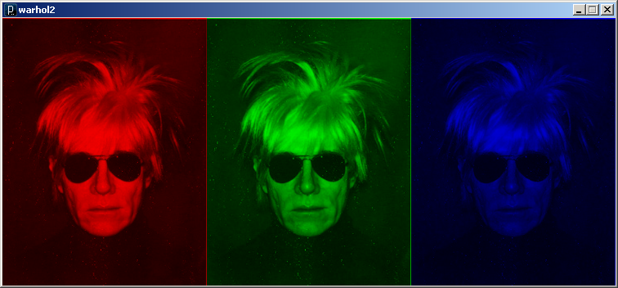
Image Processing
// warhol
void setup() {
// Load the image three times
PImage warhol = loadImage("andy-warhol2.jpg");
size(warhol.width*3, warhol.height);
// Draw modified images
tint(255, 0, 0);
image(warhol, 0, 0);
tint(0, 255, 0);
image(warhol, 250, 0);
tint(0, 0, 255);
image(warhol, 500, 0);
}

Slide 52
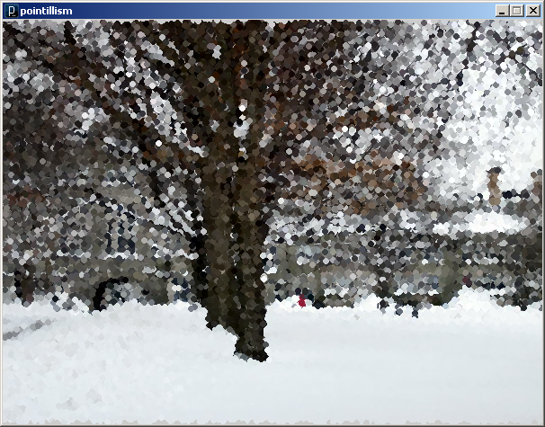
Image Processing
// pointillism
PImage img;
void setup() {
img = loadImage("bmc3.jpg");
image(img.width, img.height);
imageMode(CENTER);
image(img, width/2, height/2);
noStroke();
ellipseMode(CENTER);
loadPixels(); // Cover with random circles
for (int i=0; i<20000; i++) addPoint();
}
void addPoint() {
// Add a random filled circle to image
int x = (int)random(width);
int y = (int)random(height);
int i = x + width*y;
color c = pixels[i];
fill(c);
ellipse(x, y, 7, 7);
}

Slide 53
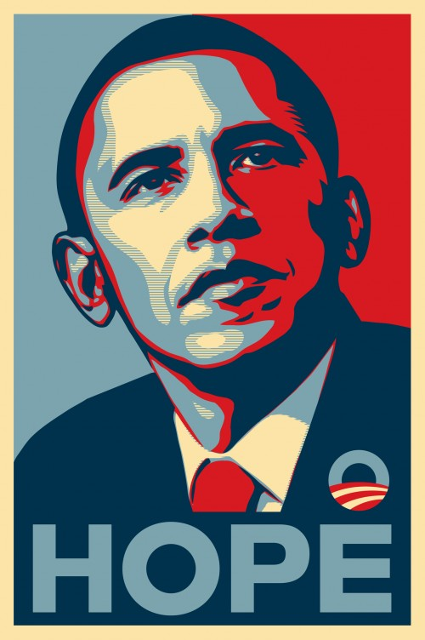
Image Processing

Slide 54
Where in the book?
Data Visualization Chapter 5, 7
Fractals & L-Systems Chapter 8
Image Processing Chapter 9, 10

